Slide 1
By Ligasyah Arnanda Primadana
DEEP : Data End-to-End Portfolio Project

Slide 2
The Dataset

Slide 3
Telco Dataset
The dataset in question is an exemplary choice for your portfolio project due to its rich and diverse content, which provides a comprehensive view of customer behavior and service usage. It includes critical information such as customer churn, service subscriptions, account details, and demographic data. This allows for a multifaceted analysis, enabling you to develop focused customer retention programs. By leveraging this dataset, you can showcase your ability to perform sophisticated data analyses and predictive modeling, thereby demonstrating your proficiency in deriving actionable insights that are crucial for strategic decision-making in the telecommunications industry.
Here is a concise explanation of the key business processes:
Customer Retention Management: Analyze customer behavior to identify churn factors and develop retention strategies.
Service Subscription Analysis: Evaluate customer service subscriptions to inform service enhancements and bundling.
Billing and Payment Processing: Manage account details and billing practices to ensure customer satisfaction and revenue collection.
Demographic Analysis: Use demographic data to segment customers and tailor marketing efforts.
Customer Support and Service Enhancement: Improve customer service by analyzing tech support and service issues.
These processes are essential for enhancing customer experience and business growth.

Slide 4
RevoLeague : Telecommunications customer loyalty

Slide 5
Business Context
RevoLeague is a prominent player in the telecommunications industry, renowned for its innovative services and customer-centric approach. As part of its strategic initiative to enhance customer satisfaction and loyalty, RevoLeague has embarked on an analytical journey to predict customer behavior with the ultimate goal of retaining its valued clientele.

Slide 6
DARCI
Chief Marketing Officer (CMO)
Customer Experience Manager
Data Analyst Team
Customer Relationship Management (CRM)
Product Development Team
Sales Department
Customer Support Supervisor
Marketing Strategist
Marketing Department
Customer Support
Finance Department
Human Resource
Decision-Maker
Accountable
Responsible
Consulted
Informed

Slide 7
Project Scope
The project will utilize a comprehensive dataset that includes variables such as customer churn status, service subscriptions (e.g., phone, internet), account information (e.g., tenure, contract type), and demographic details (e.g., gender, age range). The focus areas of analysis will include identifying predictors of customer churn, evaluating the impact of current services on retention rates, and developing targeted strategies to enhance customer engagement. Exclusions from this scope include any analysis related to new product development outside existing services offered by RevoLeague and external market comparisons with competitors.

Slide 8
Problem Statment
RevoLeague aims to reduce customer churn by 15% over the next six months by analyzing customer data to identify key factors contributing to churn and implementing targeted retention strategies based on these insights.

Slide 9
SMART
The objective of reducing customer churn
The target of a 15% reduction in churn provides a quantifiable metric that can be tracked and assessed throughout the project duration.
RevoLeague's access to comprehensive customer data and analytical resources
Reducing customer churn is directly aligned with RevoLeague’s strategic objectives of enhancing customer satisfaction and loyalty
The inclusion of a six-month timeframe establishes urgency and allows for timely evaluation of progress
Specific
Measurable
Achievable
Relevant
Time-bound

Slide 10
Objective and Analysis Purpose
Objective
Analysis Purpose
The primary objective is to develop a predictive model that accurately identifies customers at risk of churning, enabling RevoLeague to implement targeted retention strategies aimed at reducing churn rates by 15% within six months.
The purpose of conducting a narrative analysis is to understand customer experiences and sentiments that contribute to churn.

Slide 11
MECE (Mutually Exclusive, Collectively Exhaustive)
Customer Churn
Internal
External
Customer Experience
Pricing and Promotion
Service
Product Fit
Customer Behavior
Demographic Factors
Inefficient Billing Process
Technical Issue
Lack of Competitive Price
Insufficient promotional offers
Poor customer service interactions
Inadequate service and customer needs
Customers usage product behavior
Family members
Demographic segment

Slide 12
Hypothesis
Machine Learning and EDA: If we utilize machine learning in conjunction with exploratory data analysis (EDA), then we will enhance our ability to predict customer churn by identifying key factors influencing retention.
Personalized Recommendations: If customers receive personalized service recommendations, then their likelihood of churning will significantly decrease.
Customer Support Experience: If customers have positive experiences with customer support, then their churn rates will be reduced, enabling us to implement targeted strategies for at-risk customers.

Slide 13
Key Performance Indicators (KPIs)
Churn Rate Tracks the percentage of customers who discontinue their services within a given timeframe, providing insight into potential issues leading to customer loss.
Customer Retention Rate
Measures the percentage of customers who continue their subscriptions over a specified period, indicating overall satisfaction and loyalty.

Slide 14
Analysis Methods
Exploratory Data Analysis (EDA)
Customer Churn Prediction using Machine Learning
Conducted initially to understand data distributions and relationships among variables through visualizations such as histograms, box plots, and correlation matrices; EDA helps identify patterns or anomalies in customer behavior that may contribute to churn.
Implementing various machine learning algorithms such as logistic regression, decision trees, random forests, or gradient boosting machines to build predictive models that classify customers into "churn" or "not churn" categories based on historical data.

Slide 15
Milestone 2 : Data Cleaning and EDA

Slide 16
Data Cleaning

Slide 17
The Code
Here the Google Colab :

Slide 18
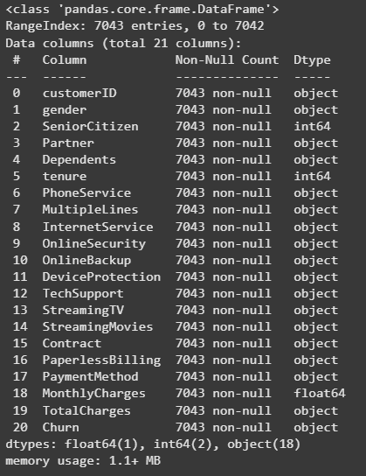
Dataset Overview
This dataset contains 7,043 entries and 21 columns, capturing customer demographics and service usage information. Most columns are of type object, representing categorical data such as gender, partner status, and payment method. Numeric columns like SeniorCitizen and tenure are correctly typed as int64, while MonthlyCharges is appropriately stored as a float64. However, the column TotalCharges is currently of type object, which is incorrect because it represents a numeric value (total amount charged). Therefore, I plan to convert the TotalCharges column to the correct numeric type (float64) to enable proper numerical analysis and calculations.

Slide 19
Data Cleaning Step
Checking Data Type
Checking Missing Value
Checking Duplicates
Checking
Typo
The only issue found is with the TotalCharges column, which was incorrectly stored as an object (string) but has now been converted to the correct numeric type (float64). All other columns have appropriate data types.
There are no missing values in any of the columns; all 7,043 entries are complete across all features.
The dataset contains no duplicate rows, ensuring that each record is unique and reliable for analysis.
No typos or inconsistent categorical values were detected in any of the string/object columns, indicating clean and consistent categorical data.

Slide 20
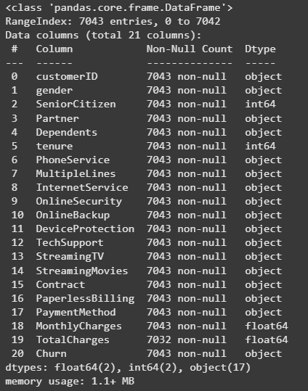
After Change DType
After converting, the TotalCharges column is now correctly set to float64, matching the numeric type of MonthlyCharges. The dataset still contains 7,043 entries and 21 columns, with most categorical features as object types and numeric columns like SeniorCitizen, tenure as int64. This change ensures accurate numerical analysis on the total charges data.

Slide 21
EDA

Slide 22
Understanding Context
In the context of the telecom industry, customer churn is a critical challenge as it directly impacts revenue and growth. Telecom companies often face moderate to high churn rates due to intense competition, service dissatisfaction, pricing issues, or contract flexibility. Our analysis reflects typical industry patterns where customers with shorter tenure, month-to-month contracts, higher monthly charges, and non-automatic payment methods are more likely to churn. Retaining customers through longer-term contracts and improving service value can significantly reduce churn rates. Understanding these factors helps telecom providers tailor strategies for customer loyalty and sustainable business performance.

Slide 23
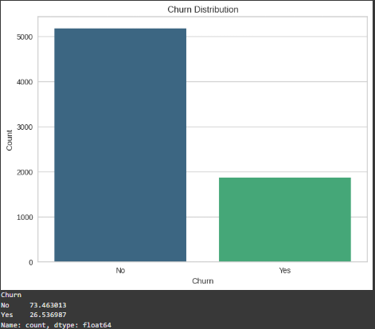
Churn Distribution
This bar chart illustrates the distribution of customer churn in the dataset. It shows that approximately 73.46% of customers did not churn, while about 26.54% did churn. The taller blue bar represents the majority who stayed, and the shorter green bar represents those who left, indicating a moderate churn rate within the customer base.

Slide 24
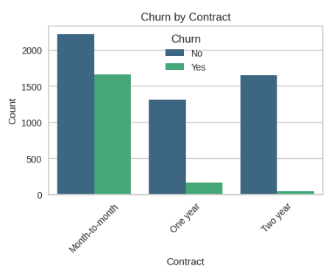
Churn by Contract
The Contract graph reveals that customers with month-to-month contracts have a substantially higher churn rate compared to those with one- or two-year contracts, indicating contract length strongly influences customer retention.

Slide 25
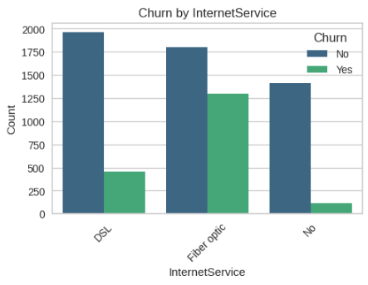
Churn by InternetService
The InternetService graph shows that customers using fiber optic service exhibit notably higher churn rates than those using DSL or no internet service, suggesting that service type impacts customer loyalty.

Slide 26
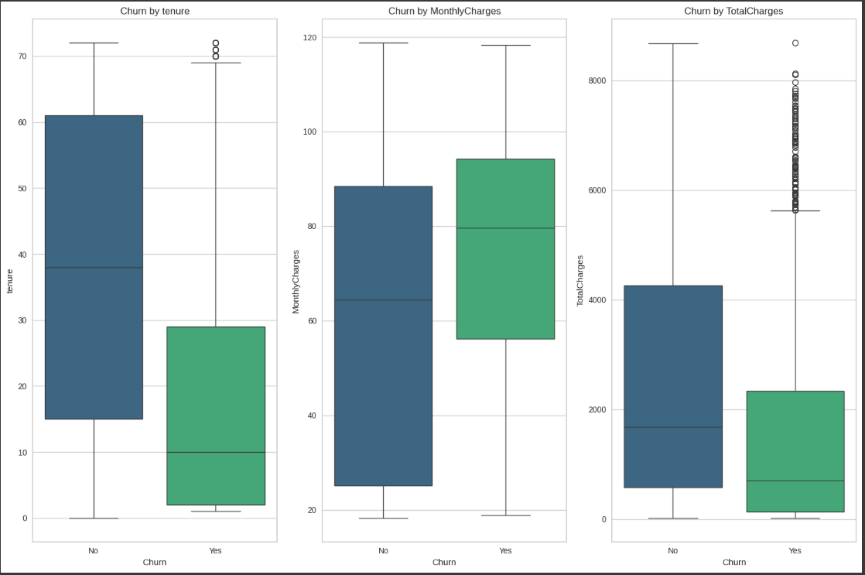
Churn by Numerical
The boxplots reveal clear differences between customers who churned and those who did not. Customers who churned tend to have significantly shorter tenure, indicating they leave earlier in their subscription period. Additionally, churned customers generally incur higher monthly charges, suggesting that higher costs may contribute to attrition. Lastly, total charges are lower for churned customers overall, likely reflecting their shorter tenure and fewer accumulated payments. These patterns highlight tenure and pricing as important factors influencing customer churn.

Slide 27
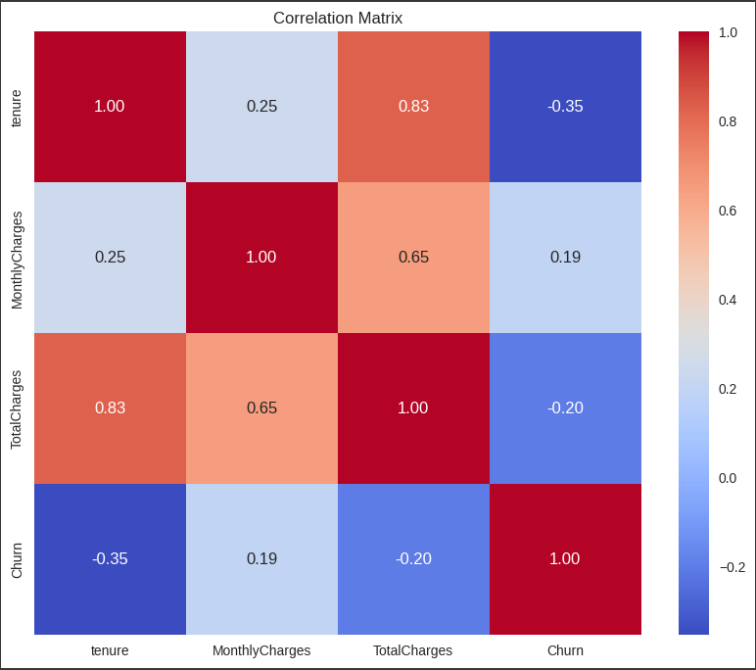
Churn by Numerical
This correlation matrix shows relationships between key numerical variables and churn. Notably, tenure has a moderate negative correlation with churn (-0.35), indicating that customers with longer tenure are less likely to churn. MonthlyCharges has a weak positive correlation (0.19) with churn, suggesting higher monthly fees slightly increase the chance of churn. TotalCharges also shows a weak negative correlation (-0.20) with churn, reflecting that customers who have paid more overall tend to stay longer. Strong positive correlations exist between tenure and total charges (0.83), as well as between monthly charges and total charges (0.65), which is expected since total charges accumulate over time based on monthly fees.

Slide 28
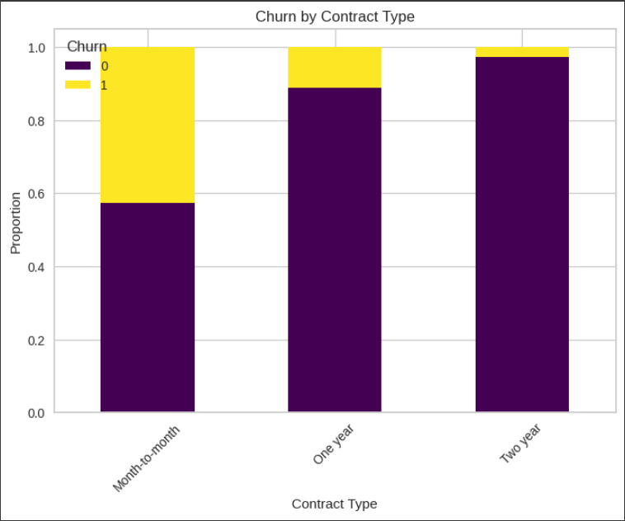
Churn by Contract Type
This stacked bar chart shows the proportion of customers who churned (yellow) versus those who stayed (purple) across different contract types. It clearly indicates that customers with month-to-month contracts have a much higher churn rate compared to those with one-year or two-year contracts, where churn is minimal. This highlights that longer-term contracts are associated with better customer retention.

Slide 29
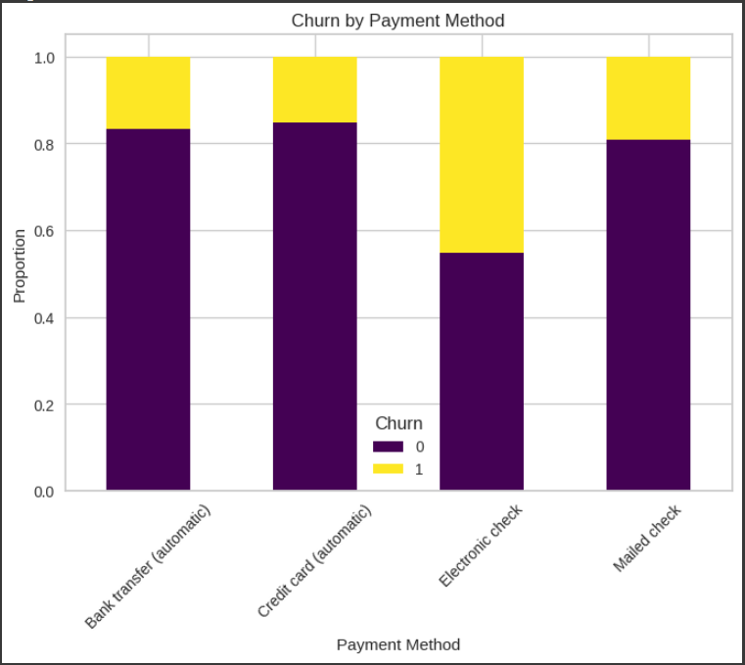
Churn by Payment Method
This bar chart illustrates the churn rates across different payment methods. Customers who pay via electronic check exhibit a noticeably higher churn rate compared to those using bank transfer, credit card, or mailed check. The lower churn proportions for automatic payment methods (bank transfer and credit card) suggest that automated payments may contribute to better customer retention. This insight highlights the importance of encouraging customers to adopt automatic payment options to reduce churn.

Slide 30
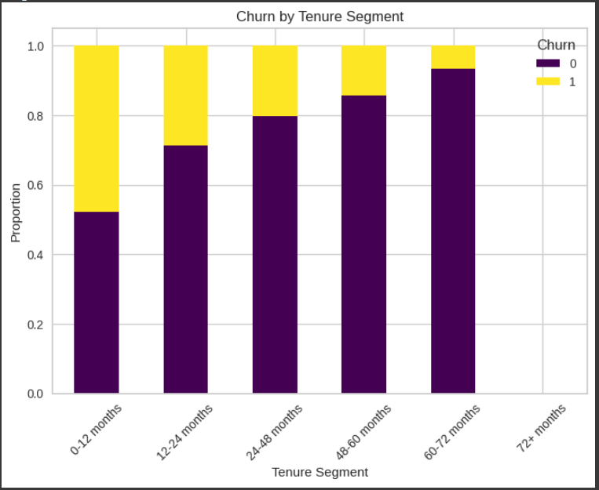
Churn by Numerical
This bar chart shows that the churn rate decreases as customer tenure increases. Customers in the 0-12 months segment have the highest proportion of churn, while those with longer tenures, especially beyond 60 months, exhibit much lower churn rates. This indicates that customers who stay longer are less likely to leave, emphasizing the importance of early retention efforts to reduce churn.

Slide 31
The Dashboard
Here the Tableau Public Dashboard :

Slide 32
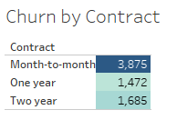
Churn by Contract
Insights from the Table
Month-to-month contracts have the highest churn number (3,875), indicating these customers are the most at risk.
One-year and two-year contracts have significantly lower churn numbers (1,472 and 1,685 respectively), suggesting longer contracts improve retention.
Business Recommendations
Focus Retention Efforts on Month-to-Month Customers
Develop targeted offers or incentives to encourage these customers to switch to longer-term contracts.
Use predictive modeling to identify which month-to-month customers are most likely to churn and proactively engage them.

Slide 33
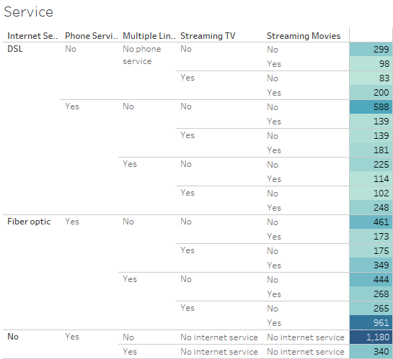
Churn by Service
Insights from the Service Table
Customers with DSL internet and no phone service or no streaming services tend to have lower counts compared to those with multiple services.
Fiber optic customers with multiple services (phone, streaming TV, streaming movies) show higher numbers, indicating these customers might be more engaged.
Customers with no internet service but phone service have the highest count (1,180), which could be a unique segment to analyze further.
Bundling services like streaming TV and movies with internet service seems common and could influence retention.
Business Recommendations
Encourage Service Bundling
Promote bundles combining internet (especially fiber optic) with streaming and phone services to increase customer stickiness.
Use targeted offers to upsell streaming or phone services to DSL or no-internet customers.

Slide 34
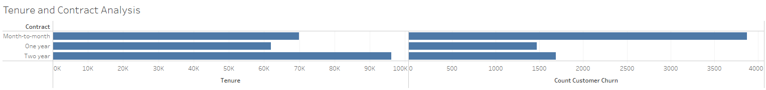
Churn by Tenure and Contract
Insights from the Chart
Month-to-month customers have the highest churn count and relatively lower total tenure, indicating they are more likely to leave quickly.
Customers with two-year contracts have the highest total tenure and lower churn counts, showing longer contracts help retain customers longer.
One-year contracts fall in between, with moderate tenure and churn.
Business Recommendations
Leverage Tenure Data
Use tenure as a key feature in your churn prediction model to identify customers who might be nearing a churn risk period.
Tailor retention efforts based on how long a customer has been with the company.

Slide 35
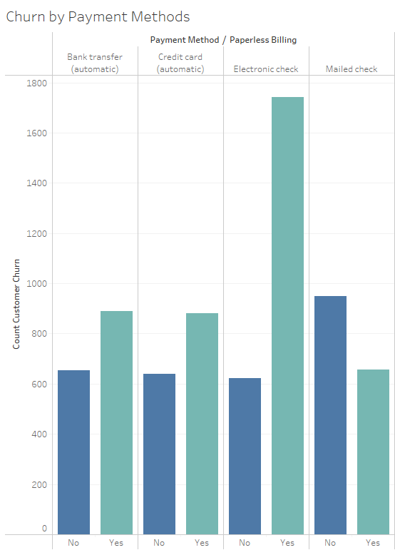
Churn by Payment Methods
Insights from the Chart
Customers using Electronic Check with paperless billing have the highest churn count, indicating this group is at significant risk.
Other payment methods like bank transfer and credit card (automatic) show lower churn rates, especially when paperless billing is not enabled.
Paperless billing seems to increase churn risk for some payment methods, particularly electronic checks.
Business Recommendations
Target Electronic Check Users with Paperless Billing
Investigate why this group has higher churn—could be payment issues or dissatisfaction.
Offer incentives or alternative payment options to reduce churn risk.

Slide 36
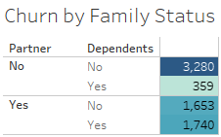
Churn by Family Status
Insights from the Data
Customers without a partner and without dependents have the highest churn count (3,280), indicating they are the most likely to leave.
Customers with either a partner or dependents (or both) show significantly lower churn numbers, suggesting family status may contribute to customer loyalty.
Business Recommendations
Target Single Customers Without Dependents
Develop personalized retention offers or engagement programs for customers who are single and without dependents, as they are at higher risk.
Consider loyalty incentives or service bundles tailored to their needs.

Slide 37
Soon Machine Learning

